Slide 1
Financial Report Analysis Interactive Dashboard using Power BI
Presented By : Madhuri Nagare
Bachelors of Computer Application
Tools Used: Power BI, Excel Dataset

Slide 2
Power BI Desktop
KPI Sales
Total sales by Country wise Segment
Total Profit by Product
Total COGS by Country
25.03M
3.03

M
22.03



Slide 3
Power BI Desktop
Slicer
Year, Month

Product

Segment

Country



2013

Amarilla

Channel Partners

Canada


2014

Carretera

Enterprise

France

Montana

Government

Germany

Paseo

Midmarket

Mexico

Velo

Small Business

United States of America

VTT

Slide 4
Power BI Desktop
Segment Contribution
2.38
M (2.01%
)
52.5
M (44.22%
19.61
M (16.52%
)
)
Segment
Government
Small Business
Enterprise
Midmarket
Channel Partners
42.43
M (35.74%
)

Slide 5
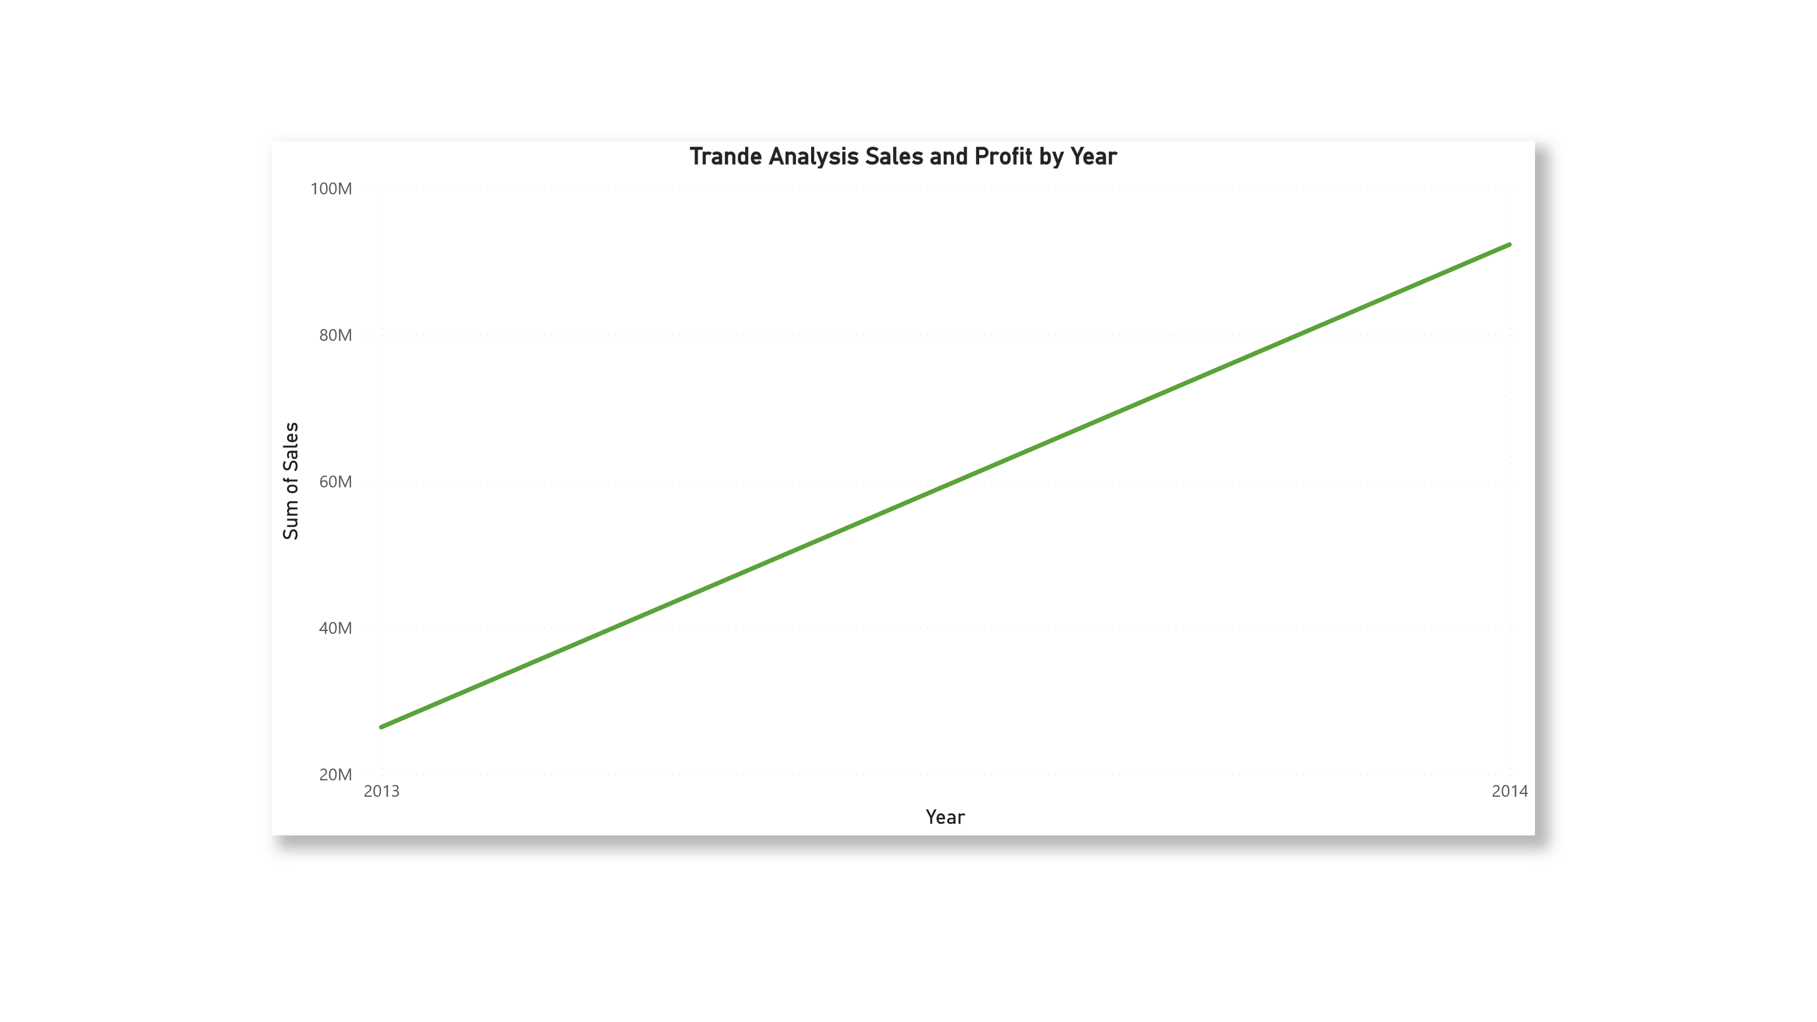

Slide 6
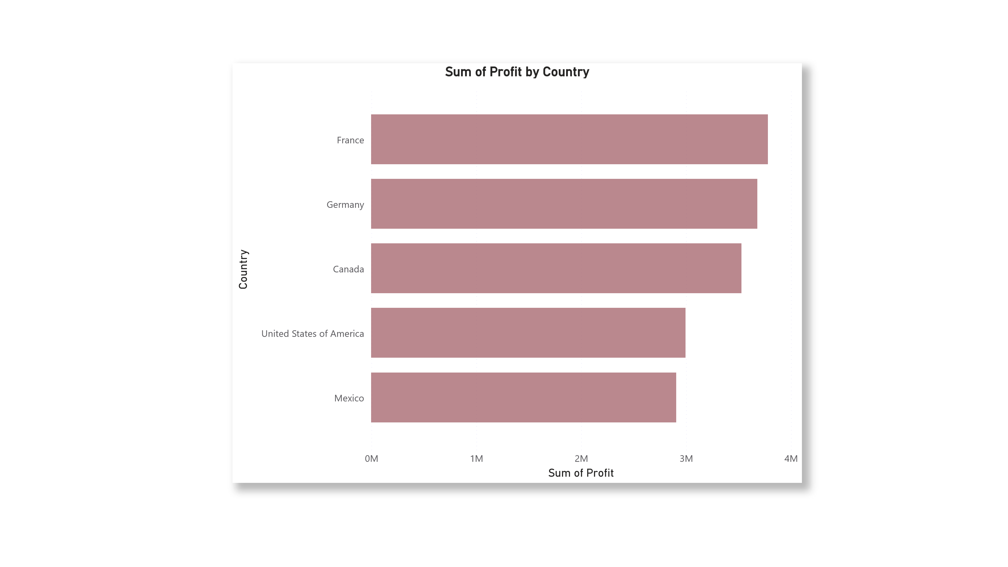

Slide 7
Power BI Desktop
Show
Country wise Performance
United States of America
France
Mexico
Canada
Germany

Slide 8
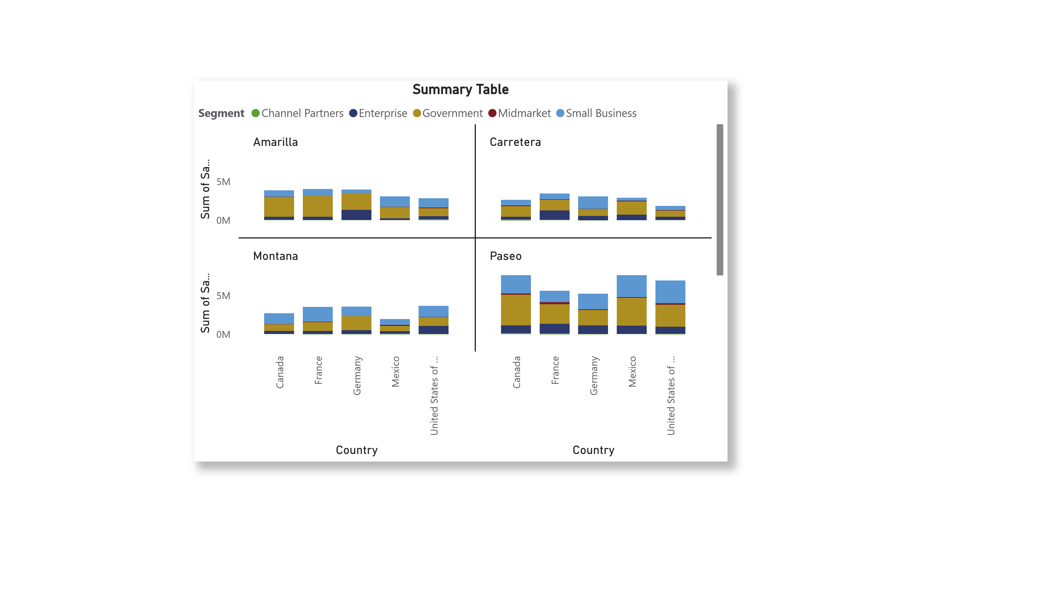

Slide 9
